Slide 1


Data Science Capabilities PPT

Slide 2

Agenda
01
Who we are
02
What is Data science
03
What is the application areas
04
Application Areas
05
What we Offer

Slide 3





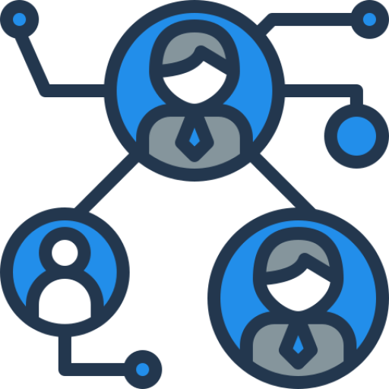






WHO WE ARE
“ We are a core technology based solution provider who develop cutting edge technologies to support OEM's to bring their product into market quickly. ”
Over a decade of expertise in the area of wireless communication and Embedded technology.
Indian Company having branches outside.
Major clients and partners.
Diverse Service offerings in areas like PMR, Wireless Technologies, IoT and Data Analytics.
20+ Qualified professionals in Wireless and Embedded Domain
© Sigtech Wireless Technologies Pvt Ltd., 2021

Slide 4
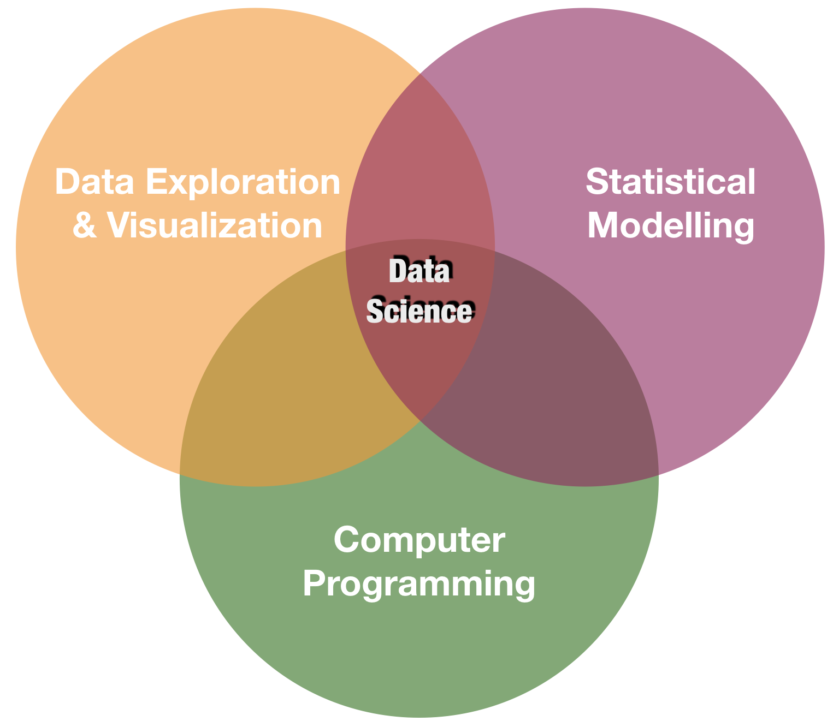
What is Data science?
Why Data science?
Is an inter disciplinary field that uses scientific methods, processes, algorithms and systems to extract knowledge and insights from structured and unstructured data.
By 2020 data driven solutions are required in every domain
We are on the way to a digital world
Large amounts of data are getting generated
Processing power becomes more
© Sigtech Wireless Technologies Pvt Ltd., 2021

Slide 5



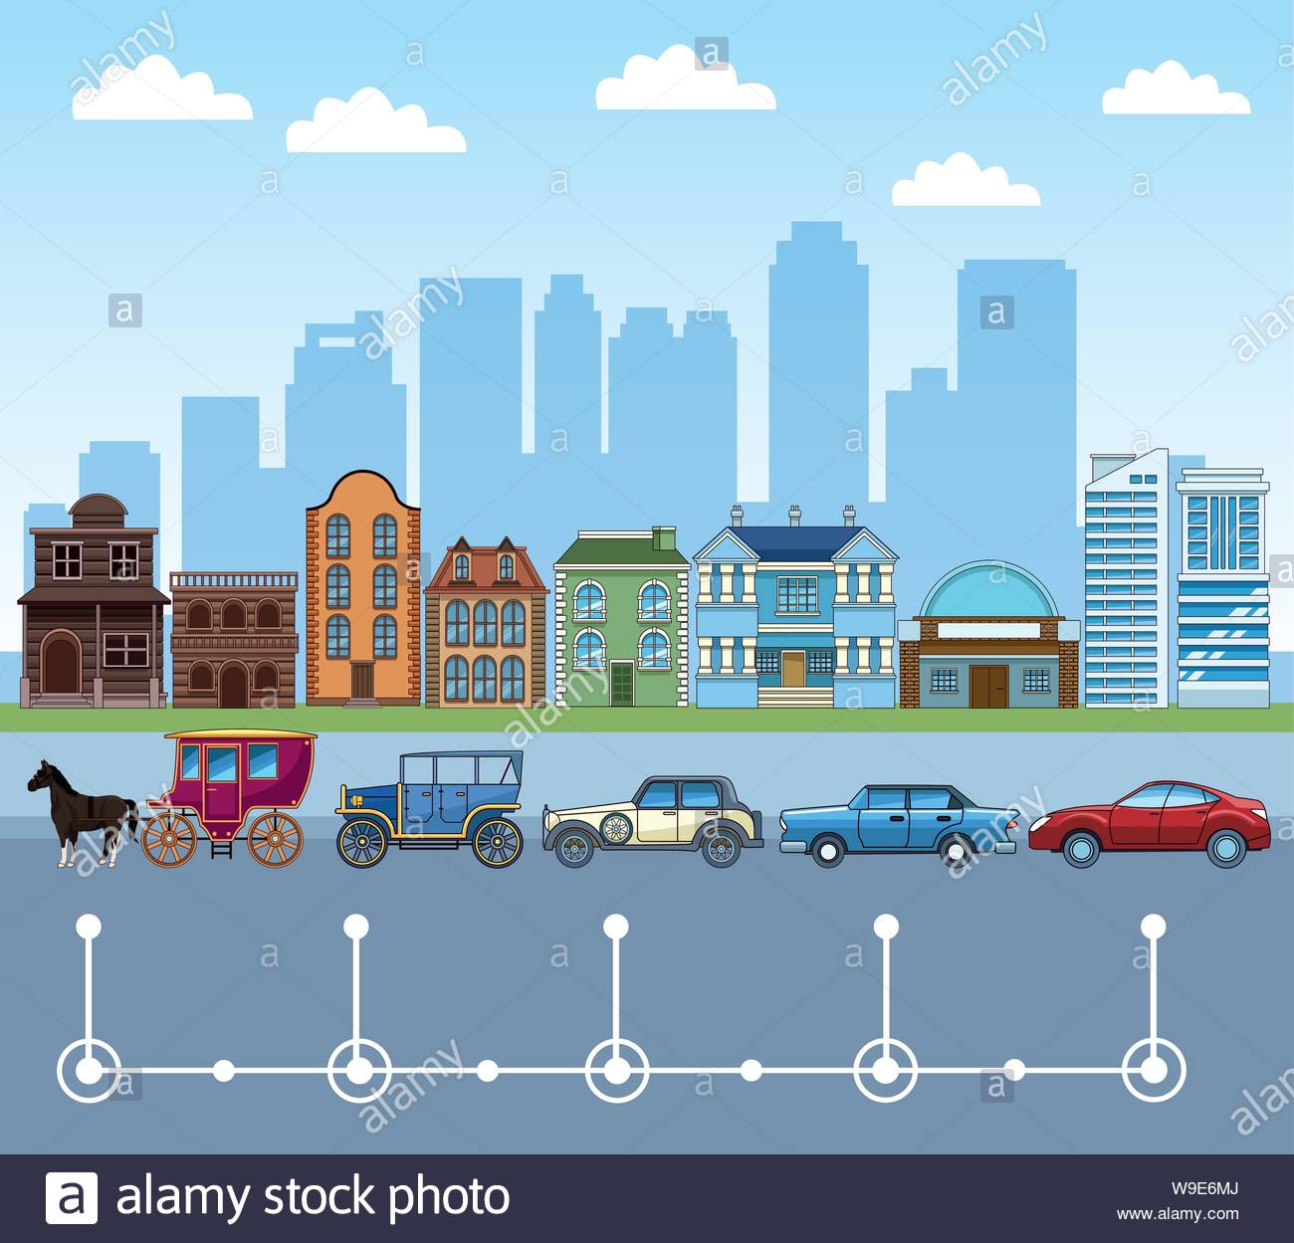


DATA SCIENCE APPLICATIONS
Identifying consumers
Recommending products
Analysing reviews
Medical image analysis
Drug delivery
Bioinformatics
Virtual assistants
E-COMMERCE
HEALTHCARE
Predicting potential problems
Monitoring systems
Automating manufacturing units
Maintenance scheduling
Anomaly detection
Self driving cars
Enhanced driving experience
Car monitoring system
Enhancing the safety of passengers
MANUFACTURING
TRANSPORT
Fraud detection
Credit risk modelling
Customer lifetime value
Customer segmentation
Strategic decision making
Risk analytics
BANKING
FINANCE
© Sigtech Wireless Technologies Pvt Ltd., 2021
This Photo by Unknown Author is licensed under CC BY-SA-NC

Slide 6

DATA SCIENCE LIFE CYCLE
On-Premises vs Cloud Database vs Files
Start
Business Understanding
Data Source
Pipeline
Streaming vs Batch low vs High frequency
Data Acquisition & Understanding
On-Premises vs cloud database vs data lake vs small vs medium vs big data
Transform, Binning Temporal, Text, Image, Feature Selection
Modelling
Environment
Feature Engineering
Wrangling, Exploration & Cleaning
Structured vs unstructured data validation and clean-up visualisation
Algorithms, Ensemble, Parameter Tuning, Model management, Retraining.
Model Training
Deployment
Customer Acceptance
End
Cross Validation, Model Reporting, A/B Testing
Model Evaluation
Scoring,Performance, monitoring etc,
© Sigtech Wireless Technologies Pvt Ltd., 2019

Slide 7
Expertise in Tools and Libraries
Apache Spark
Python
Anywhere
Jupyter Notebook
Python
R
Tableau
Flask
Plotly and Dash
Tensor flow
Pycharm
Pandas
Numpy
Seaborn
Mathplotlib
© Sigtech Wireless Technologies Pvt Ltd., 2021

Slide 8

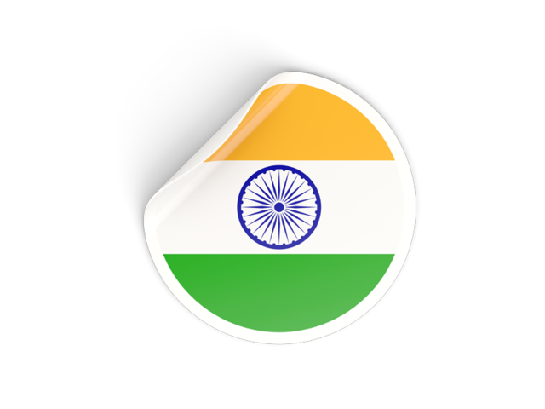

THANK YOU
Registered Office:
12 E, Basement Floor 1, Thejaswini, Technopark, Trivandrum, Kerala - 695 581, India
Regional Office:
68 - 43, Chongchun-dong, Bupyung-ku, Incheon, Korea
Phone: +91471 2700143 (I), +8210 8958 5775 (K)

Slide 9
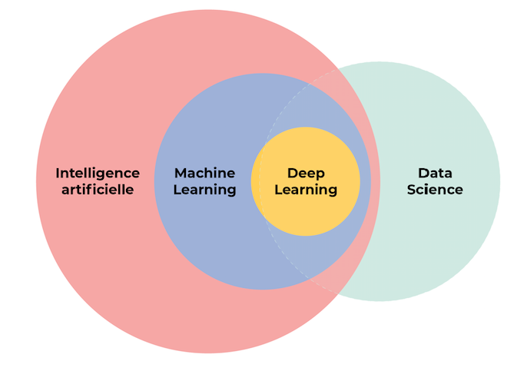
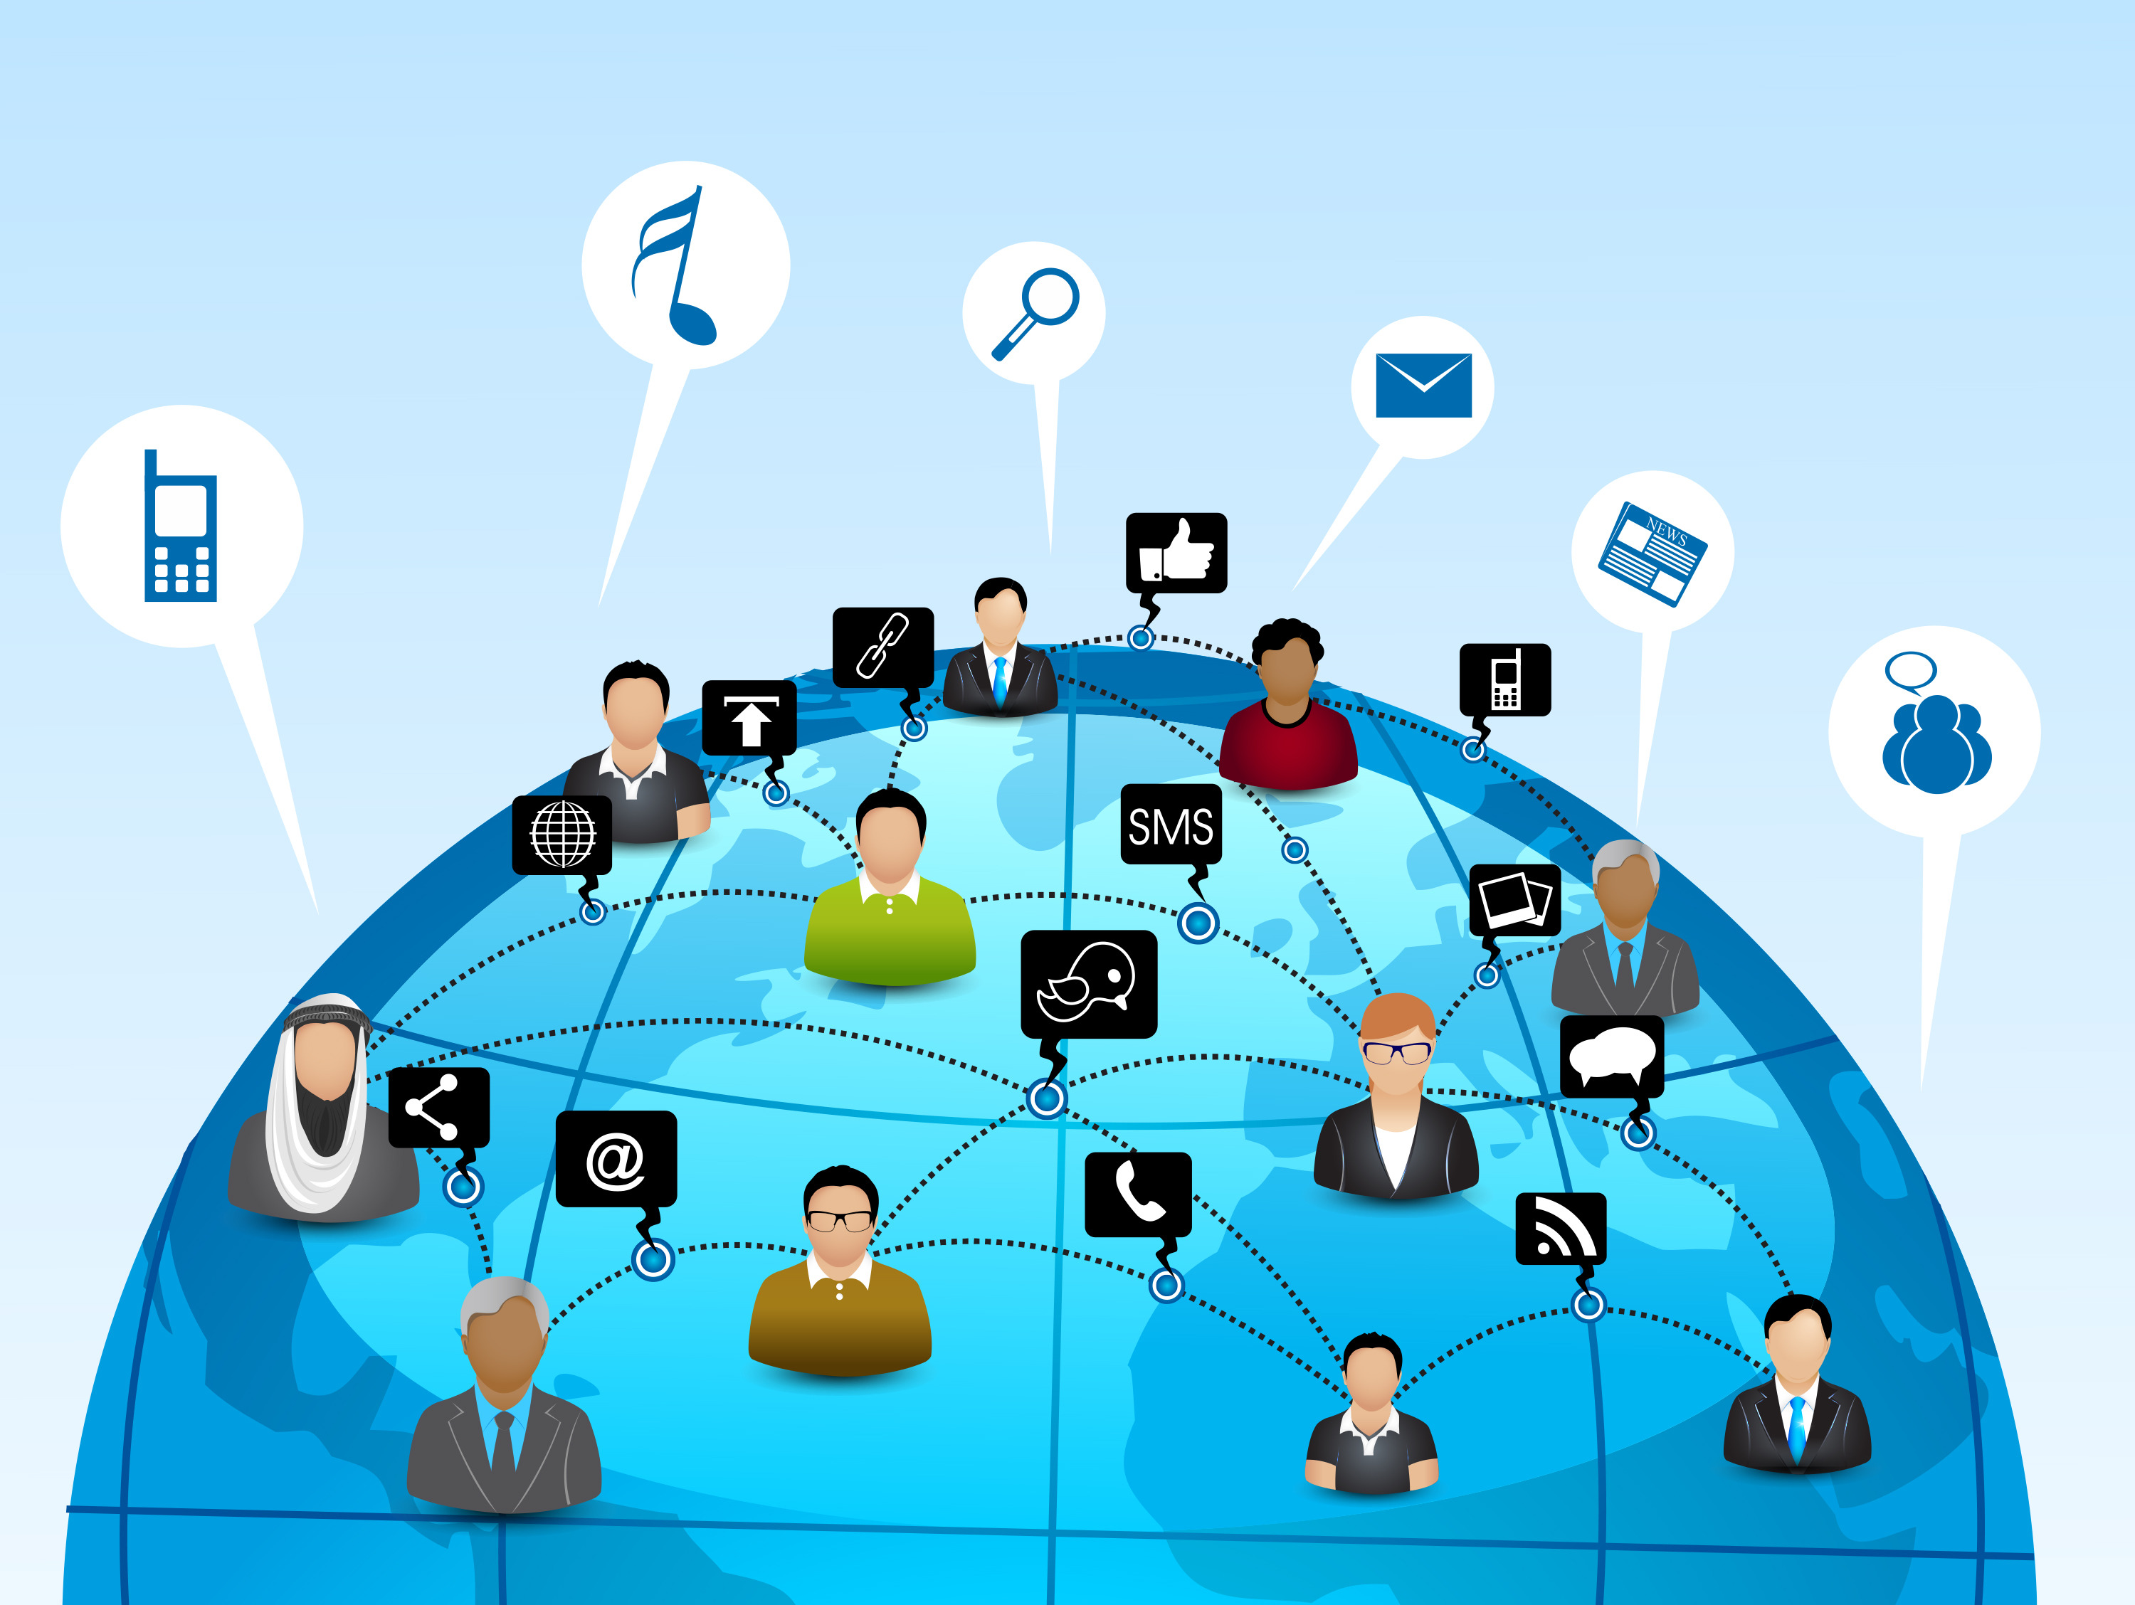


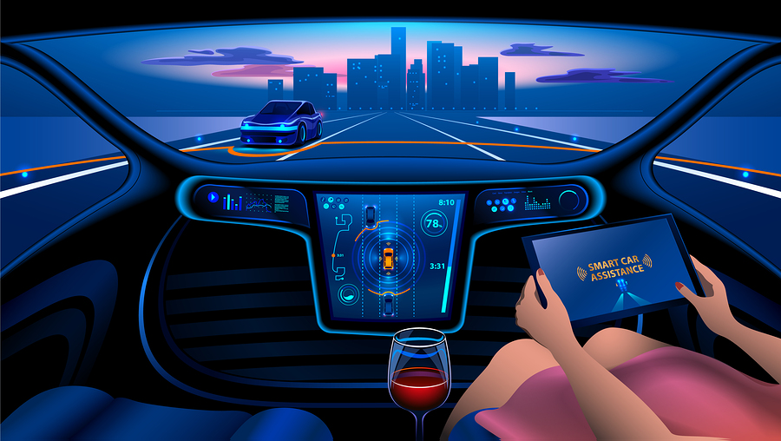


Applications
Fields of data science
E-commerce sites - amazon, flipkart
Social networking sites
Netflix
Self driving cars
Credit card fraud detection
Virtual assistant
Artificial intelligence is a technique which allows machines to mimic human behaviour.
Machine learning is a subset of AI techniques which uses statistical methods to enable machines to improve with experience.
Deep learning is a subset of MI which makes the computation of multi layer neural network feasible.
© Sigtech Wireless Technologies Pvt Ltd., 2019

Slide 10
Steps Involved
Data science life cycles
Business Requirement
Data Collection – collects all the data
Data Cleaning -Remove unnecessary data
Data Exploration & Analysis – Understand the patterns in the data
Data Modelling – Building a ML model
Data Validation – Model test with historic data
Data Visualization
Deployment
Business Requirements
Deployment
Data Acquisition
DATA SCIENCE
Modelling
Data Processing
Data Exploration
© Sigtech Wireless Technologies Pvt Ltd., 2019

Slide 11



What is Data science?
Why Data science?
It is an inter disciplinary field that uses scientific methods, processes, algorithms and systems to extract knowledge and insights from structured and unstructured data.
It is the process of using data to find solutions and predict outcomes for a problem using technology.
Data science is a "concept to unify statistics, data analysis, informatics, and their related methods" in order to "understand and analyze actual phenomena" with data.
TRAVEL
HEALTH CARE
EDUCATION
The biggest of achievements in recent times, all of them have a data driven approach in some way or the other.
© Sigtech Wireless Technologies Pvt Ltd., 2021

